Slide 1
Designing System Architecture

Slide 2
5.7 Architecture Evaluation and Refinement Cost-Benefit Analysis
A cost–benefit analysis is a widely used business tool for estimating and comparing the costs and benefits of a proposed change

Slide 3
Architecture Evaluation and Refinement Computing Benefits
A cost-benefit analysis contrasts financial benefits with financial costs, both in Dollars
Costs
Development
Operational
Benefits
Reduced Operational Costs
Increased Earnings
Payback period
the length of time before accumulative benefits recover the costs of implementation

Slide 4
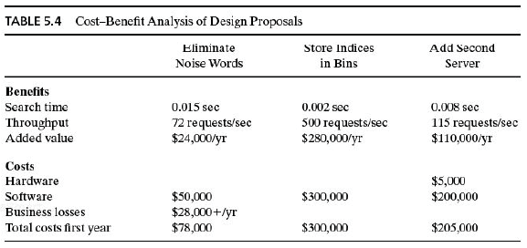

Slide 5
Architecture Evaluation and Refinement Computing Benefits (Continued)
Return on Investment (ROI)
ROI = Benefits/Cost, ROI > 1 is desired
%age gain ROI = (Benefits – Cost) / Cost x 100
Example
After five years
Cost = $ 2249559
Benefits = $ 6122893
ROI = 2.72 i.e. Total benefits are approx. 3 times the total costs
%age gain ROI = 172.19 % i.e. Your earnings are 172.19 % of the total costs

